Slide 1


Deep Learning-Based Oral Lesion Classification Using Computer Vision
ITA0502 - Computer Vision
Name of the Student:
T. VarunTej - (192511217)
Sri Arunachalam S - (192412675)
Pradeep S - (192521024)
L Sanjaykumar - (1925260168)
K.kalyan - (192525103)
Name of the Guide:
Dr. R. C. Jeni Gracia

Slide 2
6. Vision-Based Industrial Quality Inspection
Agenda
Introduction
Problem Statement
Objectives
Proposed Methodology
Modules of the Project
Techniques Used
Expected Outcomes
Conclusion

Slide 3
6. Vision-Based Industrial Quality Inspection
INTRODUCTION
Oral lesions are abnormalities in the mouth that may appear on the tongue, gums, cheeks, or other oral tissues.
Manual examination of oral lesions can be challenging and may require expert evaluation.
Computer vision techniques help analyze oral images and identify important visual patterns.
Deep learning models can classify oral lesion images based on their learned features.
This system aims to support preliminary screening and assist healthcare professionals in oral lesion assessment.

Slide 4
6. Vision-Based Industrial Quality Inspection
PROBLEM STATEMENT
Manual examination of oral lesions can be time-consuming and dependent on clinical expertise.
Visual differences between some oral lesions can make preliminary assessment challenging.
Analysing large numbers of oral images manually requires significant time and effort.
An automated system is needed to analyse oral images and identify relevant lesion patterns.
Therefore, a deep learning-based system is proposed to support oral lesion classification and preliminary screening

Slide 5
6. Vision-Based Industrial Quality Inspection
OBJECTIVES
To develop a computer vision system for analysing oral lesion images.
To preprocess images and improve their quality for further analysis.
To identify lesion regions and extract important visual features.
To classify oral lesion images using deep learning techniques.
To generate screening results and reports to support healthcare professionals.

Slide 6
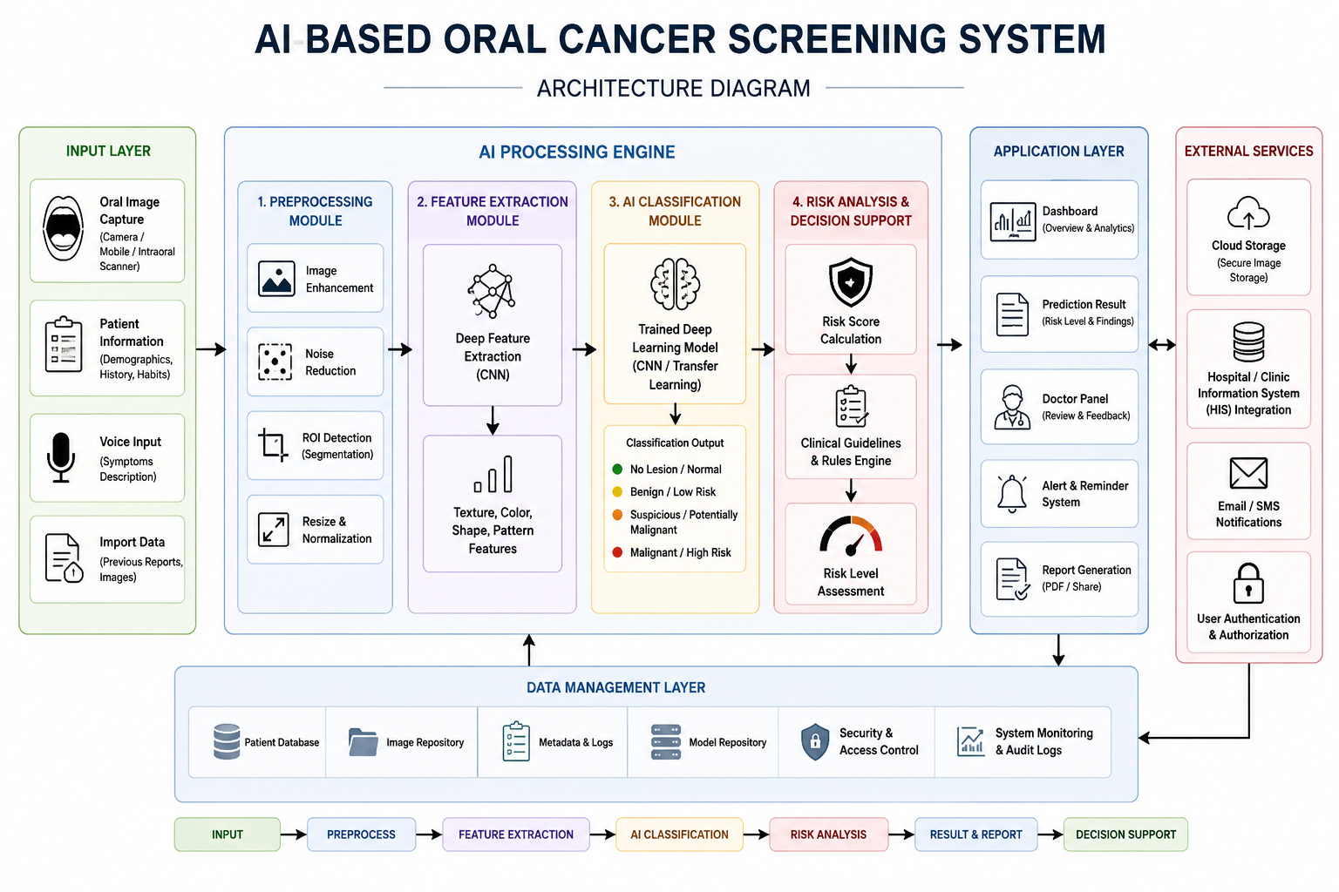
SYSTEM ARCHITECTURE
6. Vision-Based Industrial Quality Inspection

Slide 7
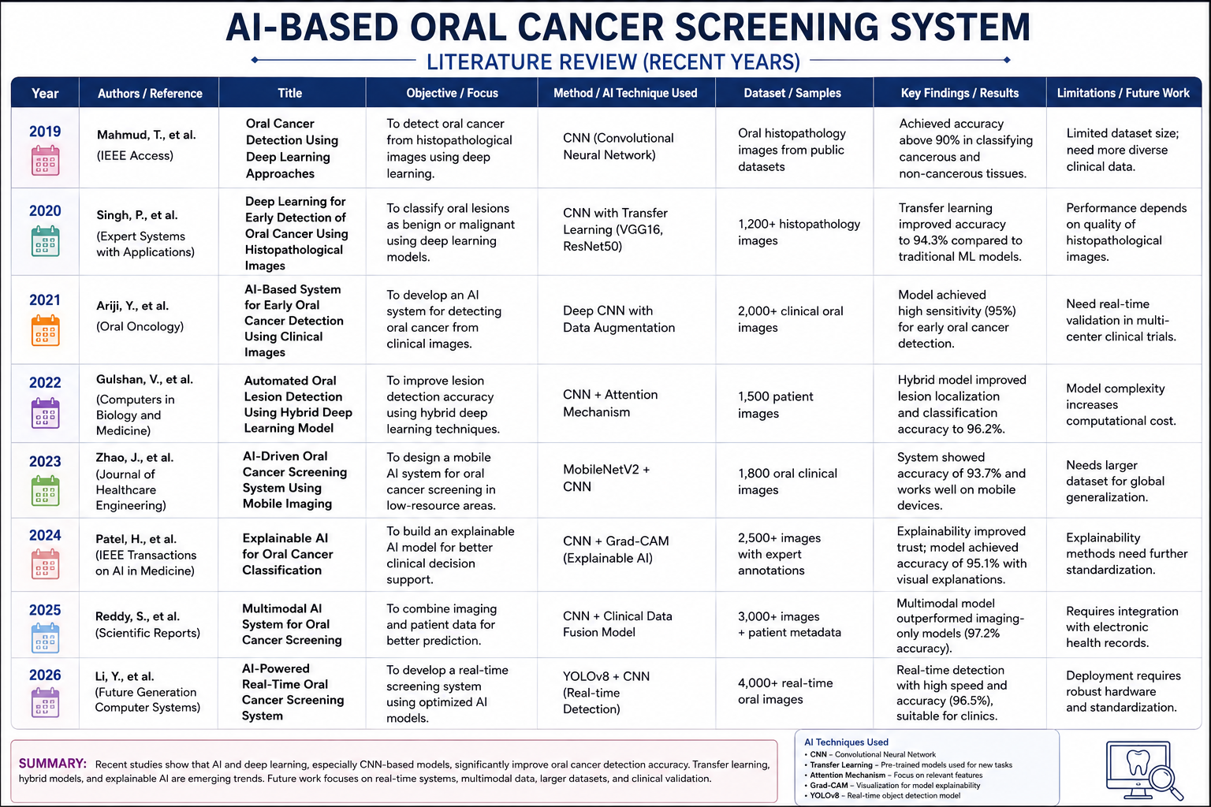
Literature Review
6. Vision-Based Industrial Quality Inspection

Slide 8
6. Vision-Based Industrial Quality Inspection
MODULES
Module 1: Image Acquisition & Preprocessing
Module 2: Image Segmentation
Module 3: Feature Extraction
Module 4: Lesion Classification
Module 5: Screening Result & Report Generation

Slide 9
THANK YOU

